Slide 1
SELENIUM

Slide 2
Selenium
Introduction
It is an open source tool. It is used for automated testing.
It is used to test only web applications.
It is not a single tool but a set of tools.

Slide 3
Selenium set of tools
Selenium IDE
Selenium Integrated Development Environment (IDE) is a Firefox plugin that lets testers to record their actions as they follow the workflow that they need to test.
Selenium RC
Selenium Remote Control (RC) was the flagship testing framework that allowed more than simple browser actions and linear execution. It makes use of the full power of programming languages such as Java, C#, PHP, Python, Ruby and PERL to create more complex tests.
Selenium WebDriver
Selenium WebDriver is the successor to Selenium RC which sends commands directly to the browser and retrieves results.
Selenium Grid
Selenium Grid is a tool used to run parallel tests across different machines and different browsers simultaneously which results in minimized execution time.

Slide 4
Selenium-Webdriver
WebDriver is a tool for automating testing web applications.
It is popularly known as Selenium 2.0.
WebDriver uses a different underlying framework,
while Selenium RC uses JavaScript Selenium-Core embedded within the browser which has got some limitations.
WebDriver interacts directly with the browser without any intermediary,

Slide 5
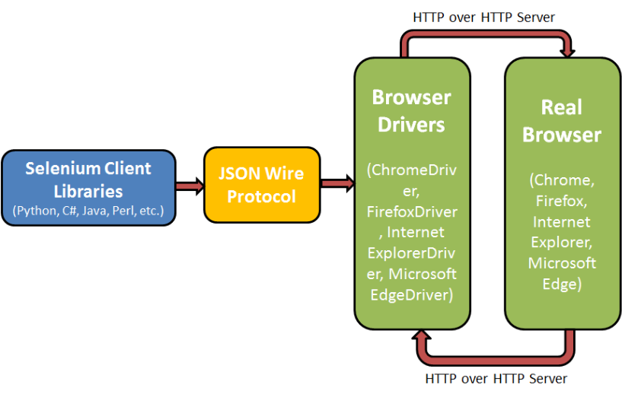
Selenium-Webdriver Architecture

Slide 6
Selenium-Webdriver
How to configure Selenium-Webdriver
Step 1
Navigate to the selenium downloads section http://www.seleniumhq.org/download/ and download Selenium WebDriver by clicking on its version
Step 2
The downloaded file is in Zipped format and one has to unzip the contents to map it to the project folder.
Step3
Now create a Java project in Eclipse and add the jars to the project
Step 4
Write the code in the Java class to conduct testing the website

